Slide 1
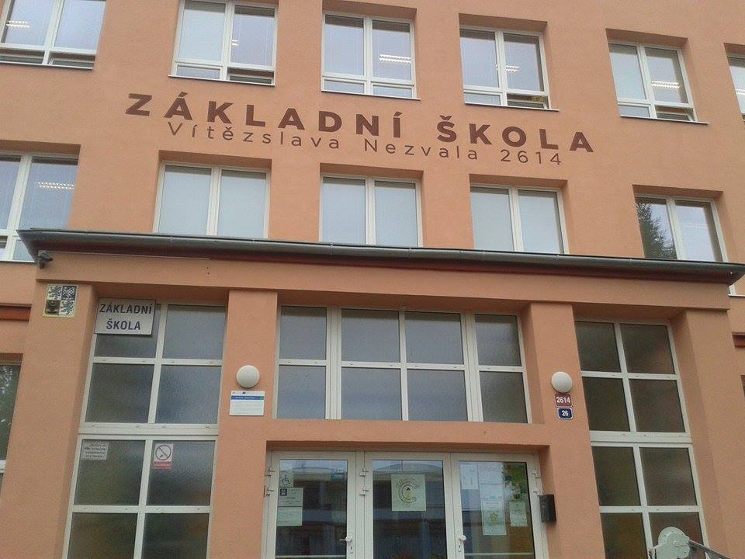
My (our) School

Slide 2
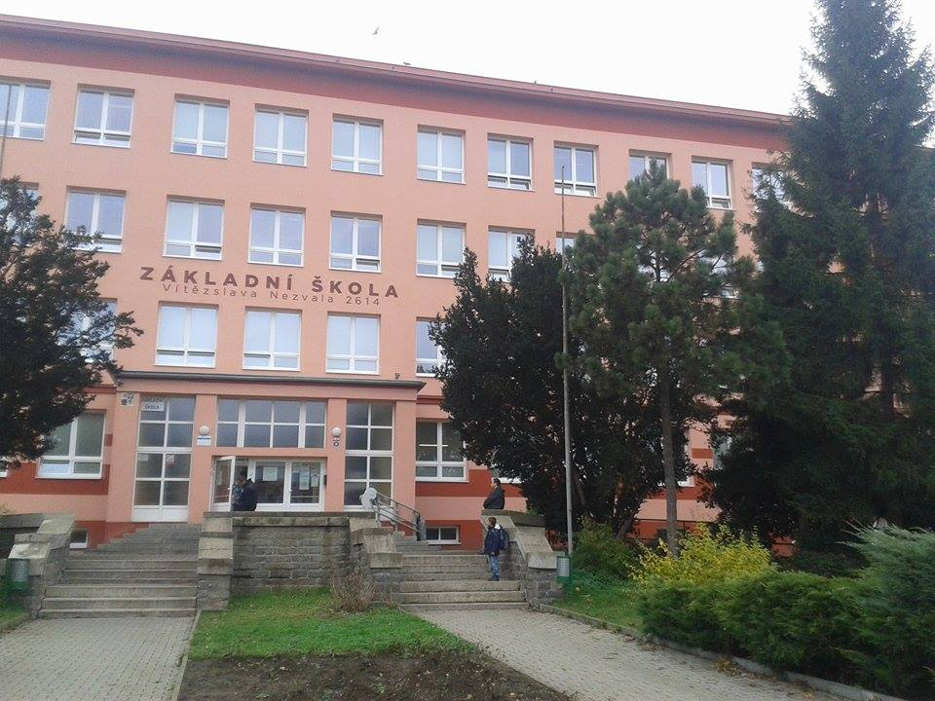
I´m from the Czech Republic.
My school is in Most.
It is about 80 km from the capital city (Prague - Praha)

Slide 3
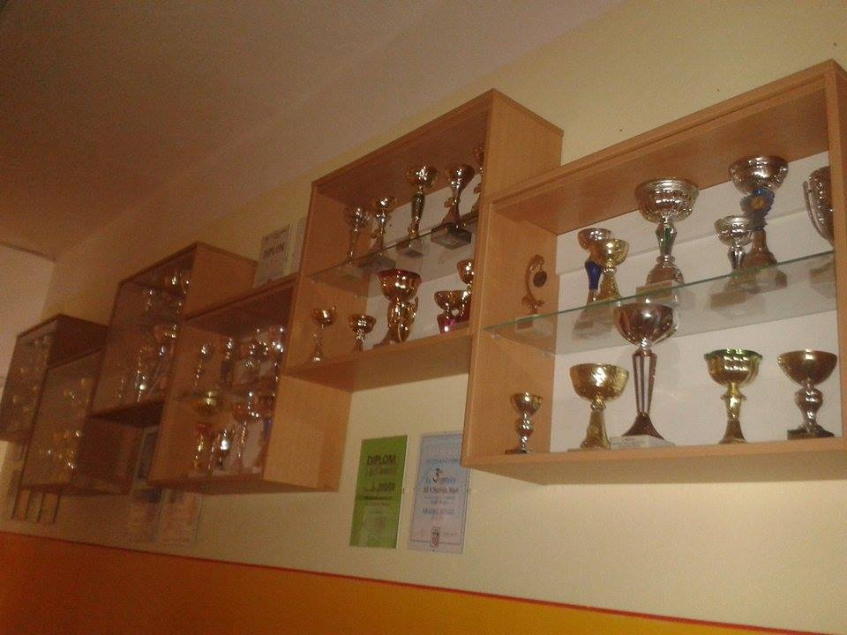
We have a lot of diplomas and cups (from sport game, science etc.)
We participate in many competitions and projects.

Slide 4
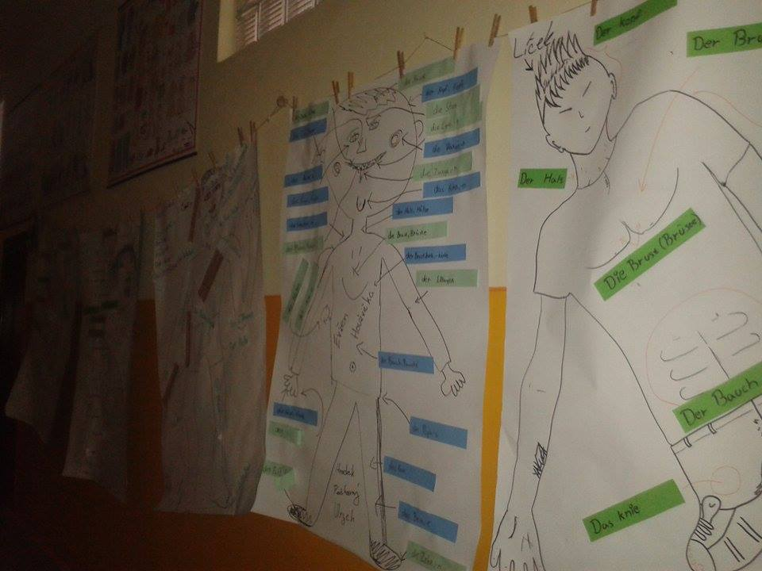
Our projects are flown on the walls.

Slide 5
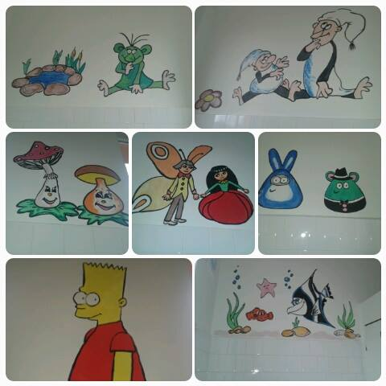
In the toilets, we drew pictures.
There are drawn Czech tales (Křemílek a Vochomůrka, Rákosníček, Motýl Emanuel a Maková panenka) and things which you know.

Slide 6
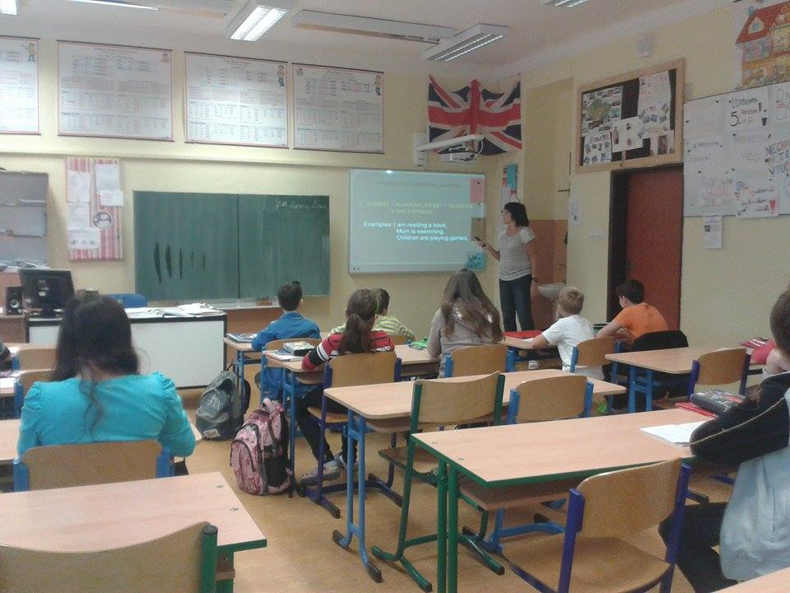
We learn the English language from 8 years.

Slide 7
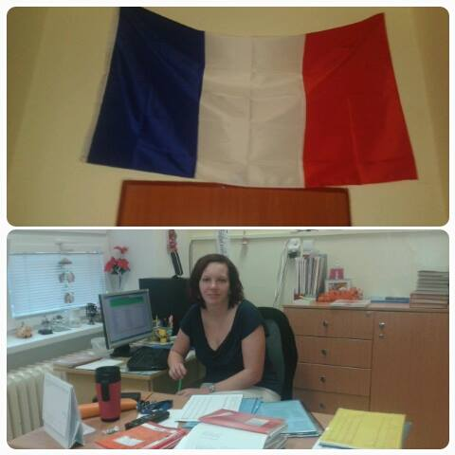
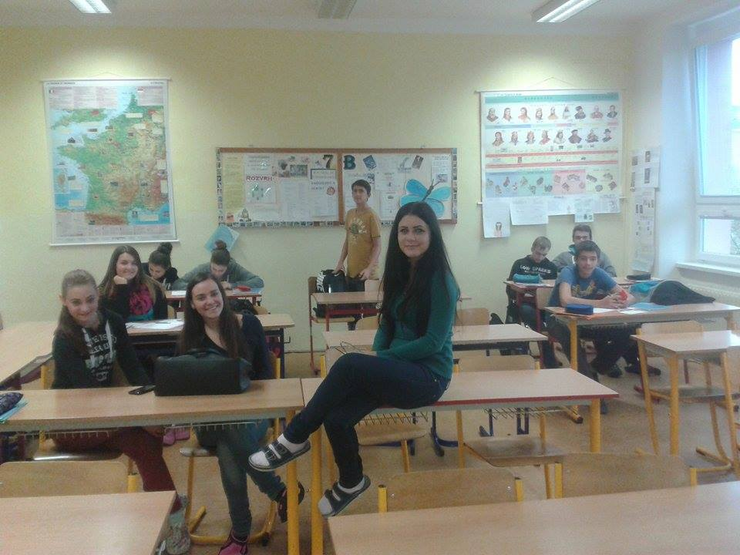
We also learn other languages : french language
Our teacher
Myself and my class.

Slide 8
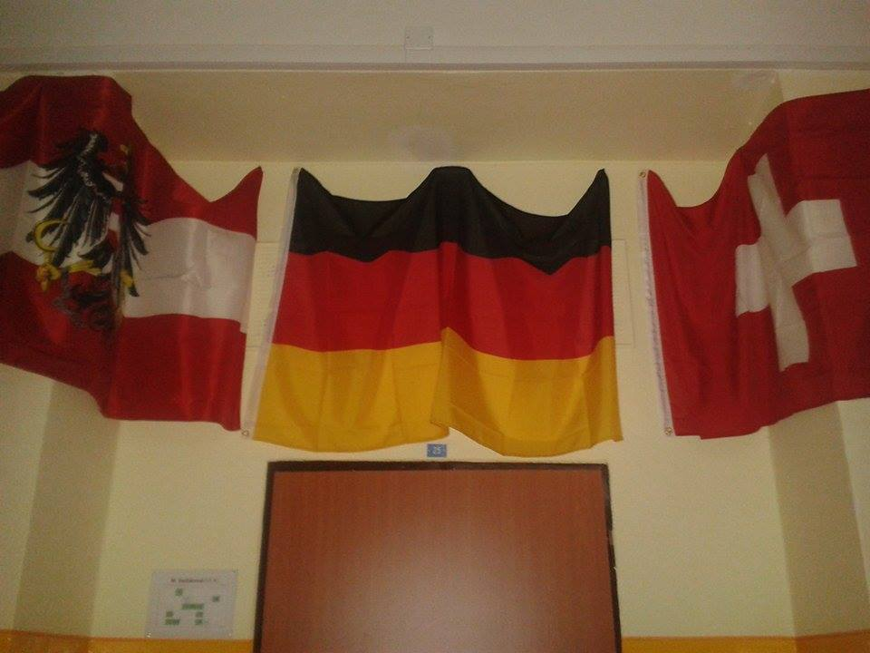
and German language.

Slide 9
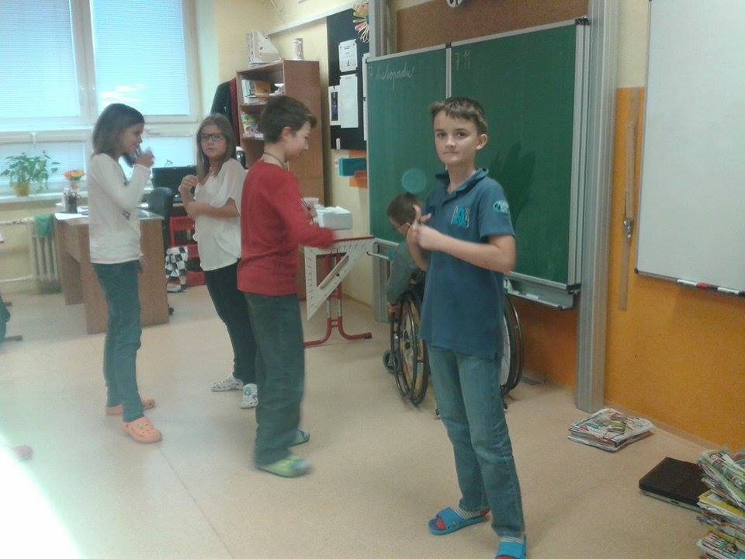
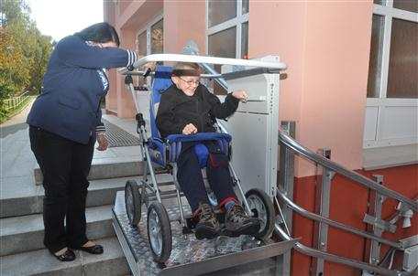
Our school is a barrier-free.

Slide 10
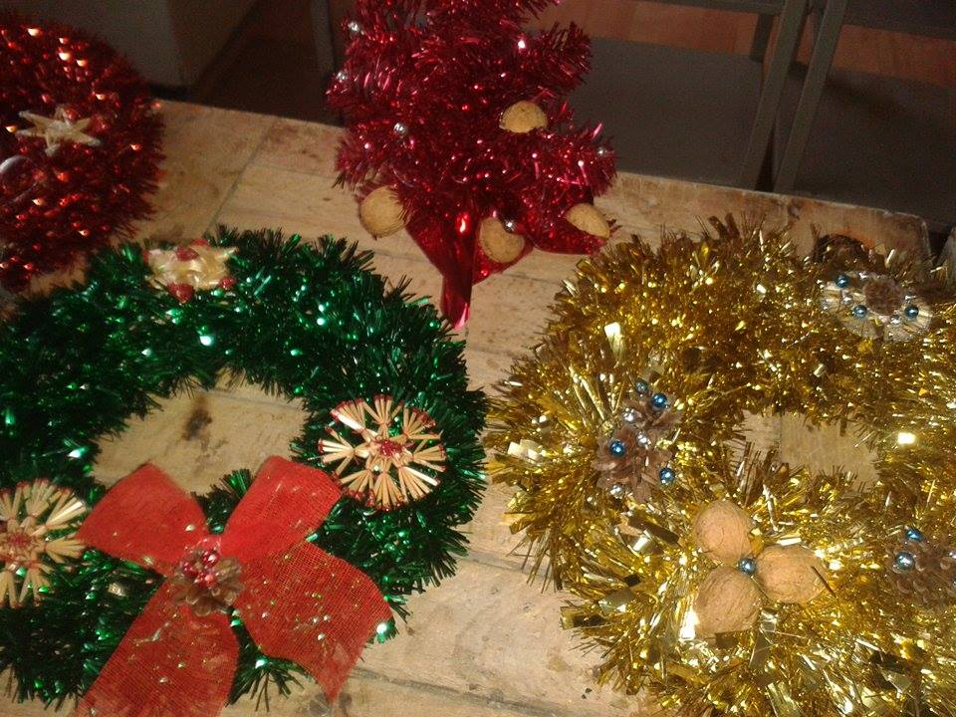
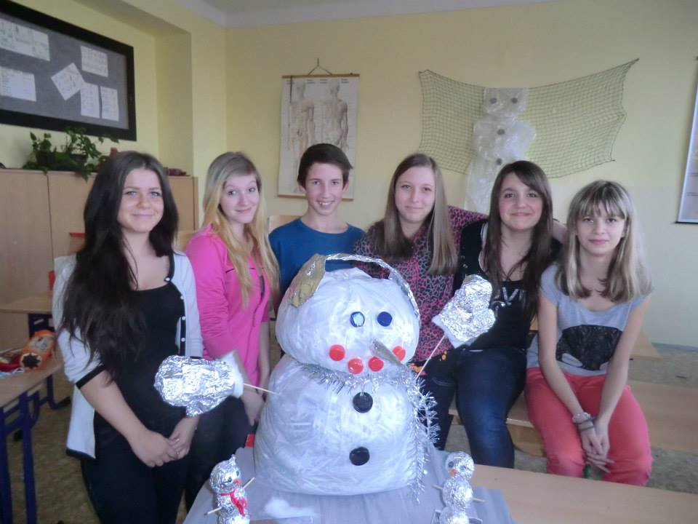
We organize a Christmas fair for parents and friends school and there we sell our products.

Slide 11
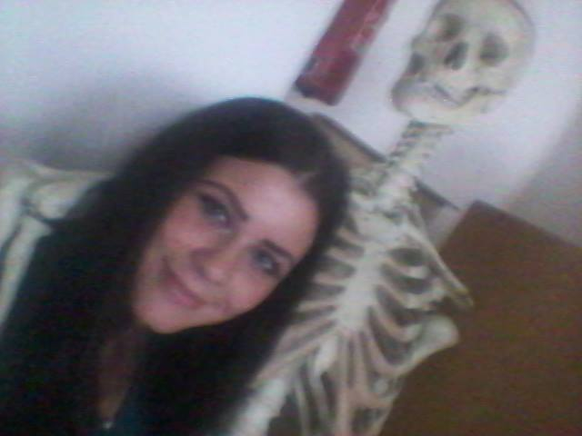
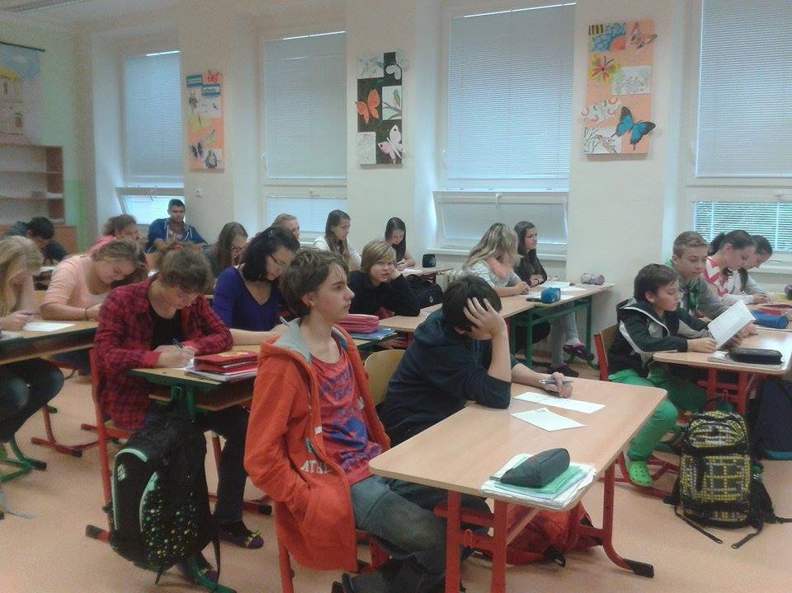
This is classroom of Science.

Slide 12
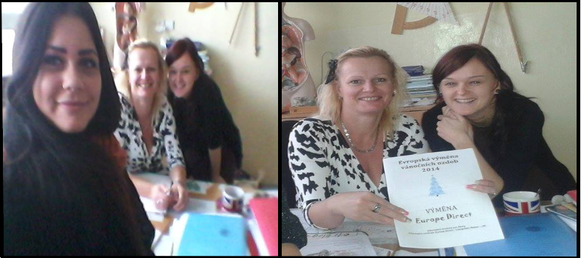
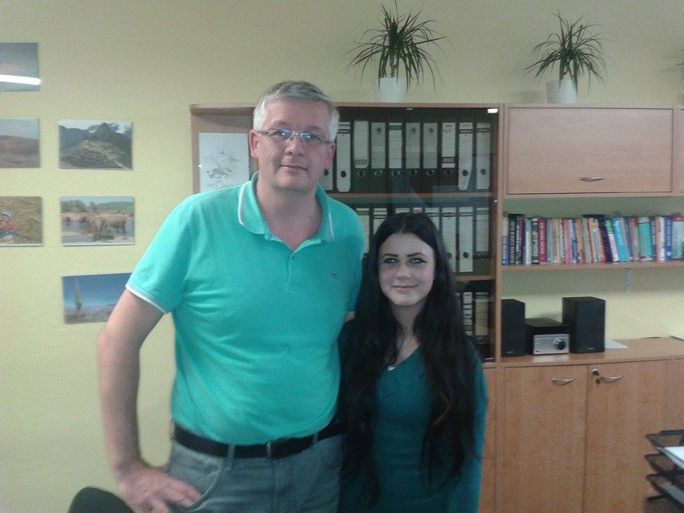
Our teachers are fine ☺
There are my teachers.
And director.

Slide 13
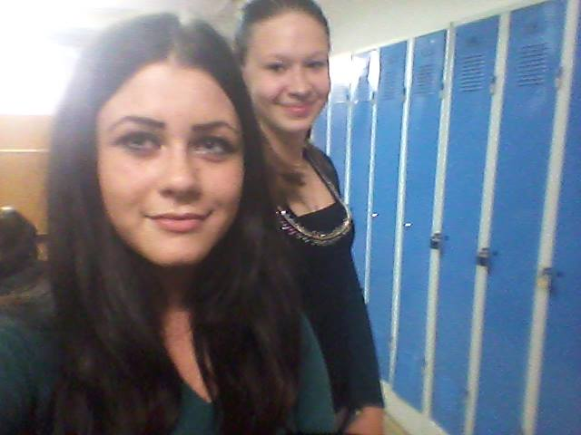
selfíííí
And this is our locker room

Slide 14
I am here for 9 years. I like this school and my classroom. I think, it‘s a great experience for me. Thanks for all of the teachers and other staff
Thank you for attention ☺
By Sabina Boušová

